Slide 1
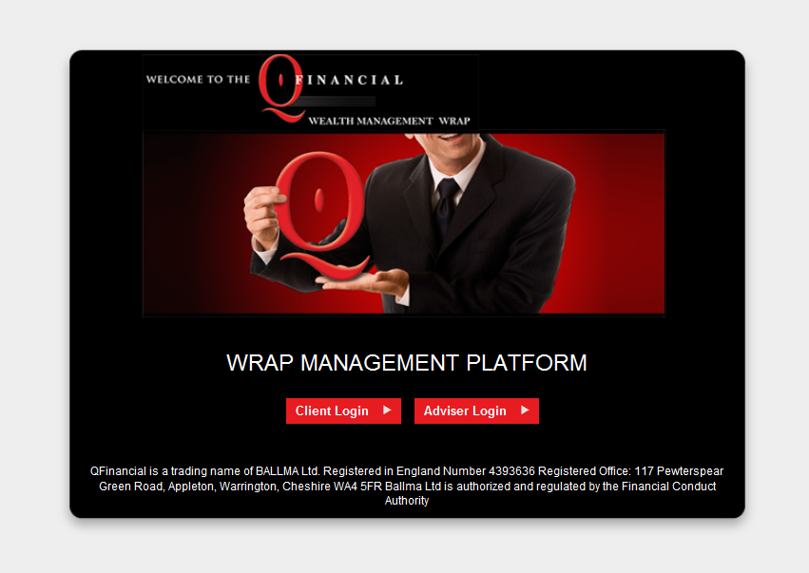
Wealth Management Log In Screen

Slide 2
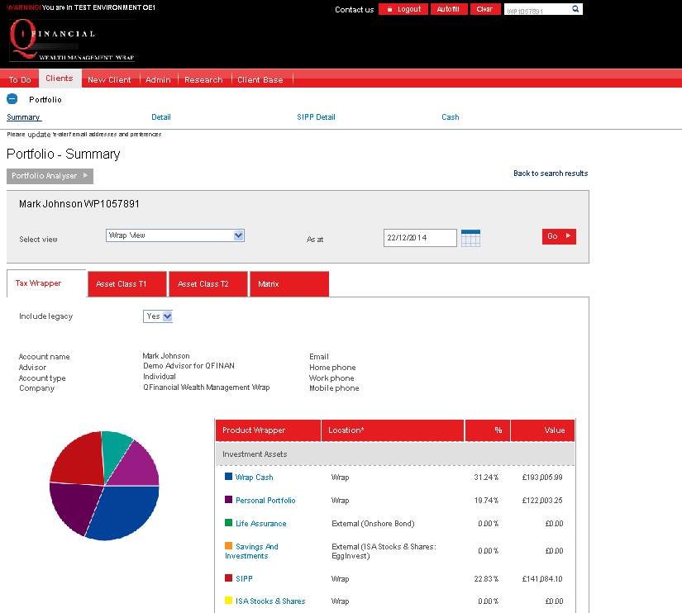
View Portfolio by Tax Wrapper
View Portfolio by Tax Wrapper

Slide 3
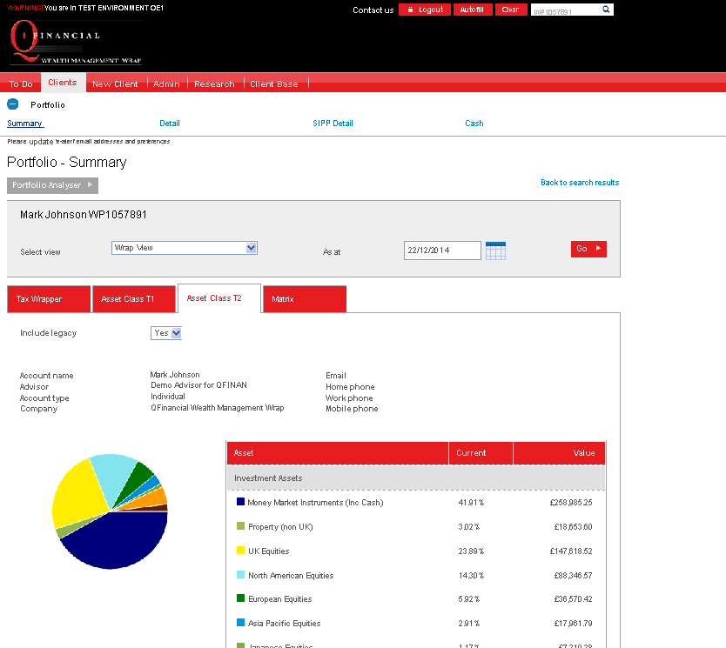
View Portfolio by Asset Class

Slide 4
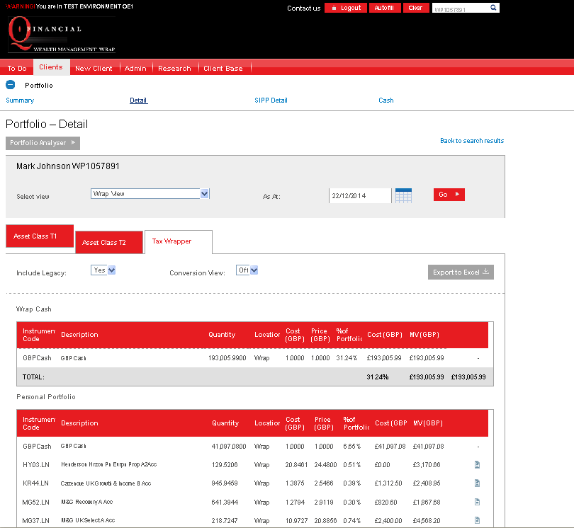
View fund details including Performance, charges, Fund Fact Sheets

Slide 5
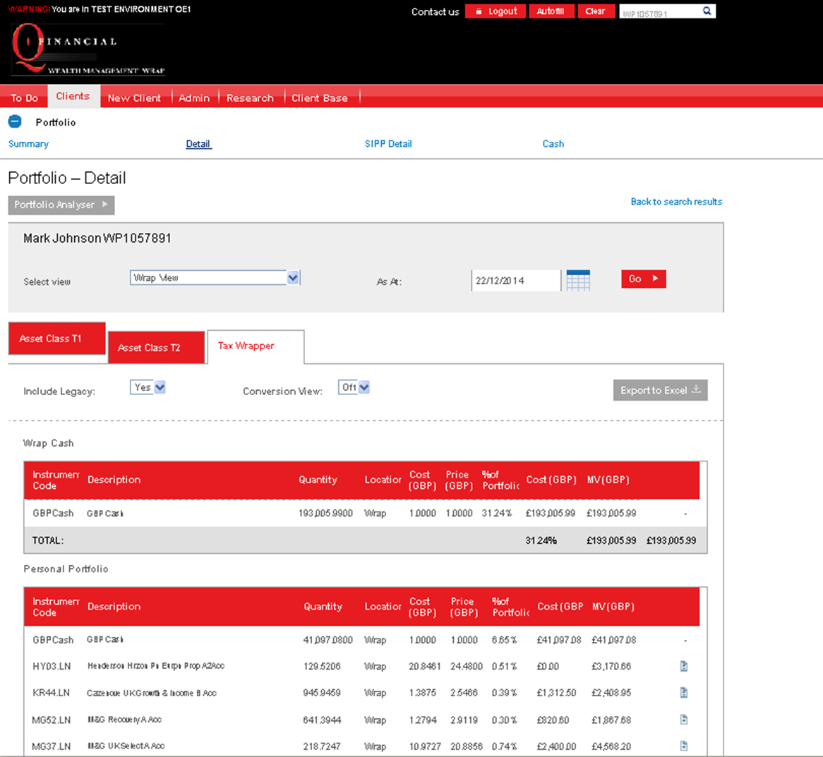
View Updated Fact Sheets

Slide 6
View Portfolio Summary, performance

Slide 7
View Market Information

